Slide 1
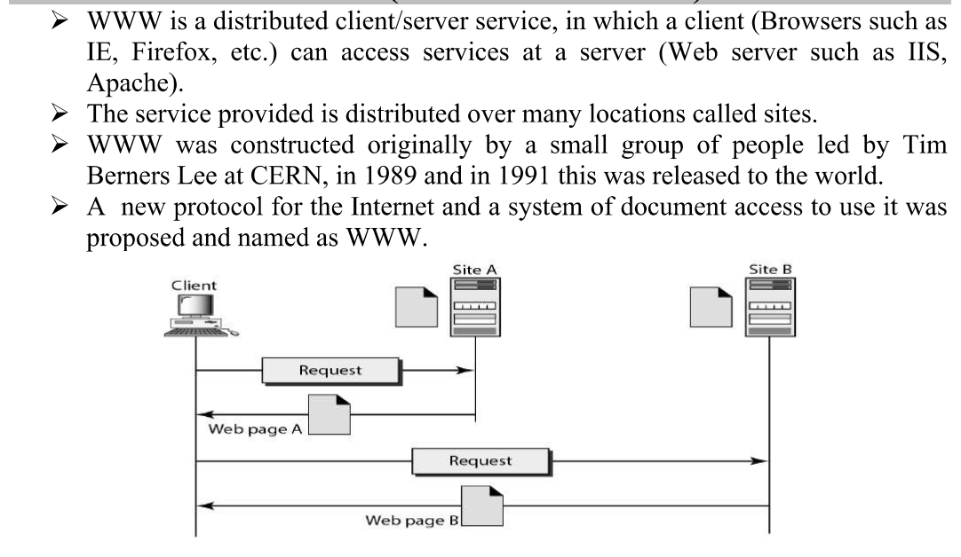
APPLICATION LAYER
Write about WWW?

Slide 2
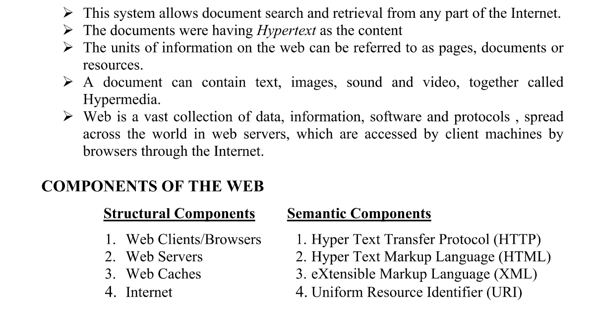

Slide 3
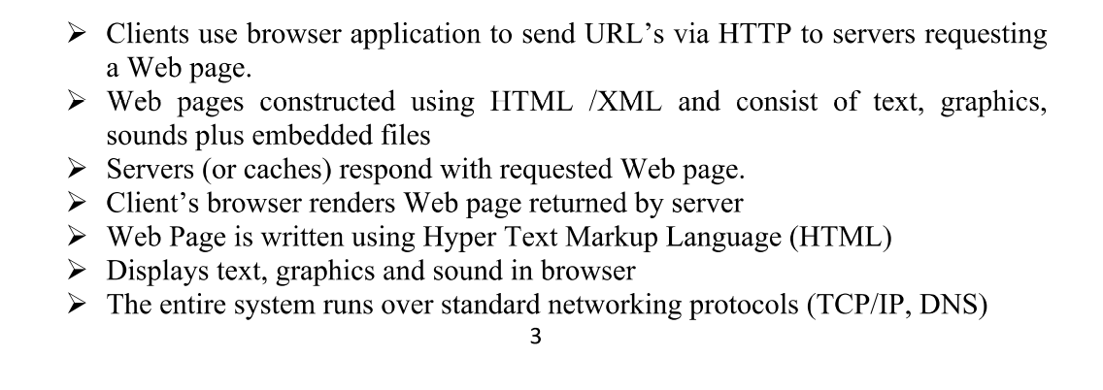

Slide 4
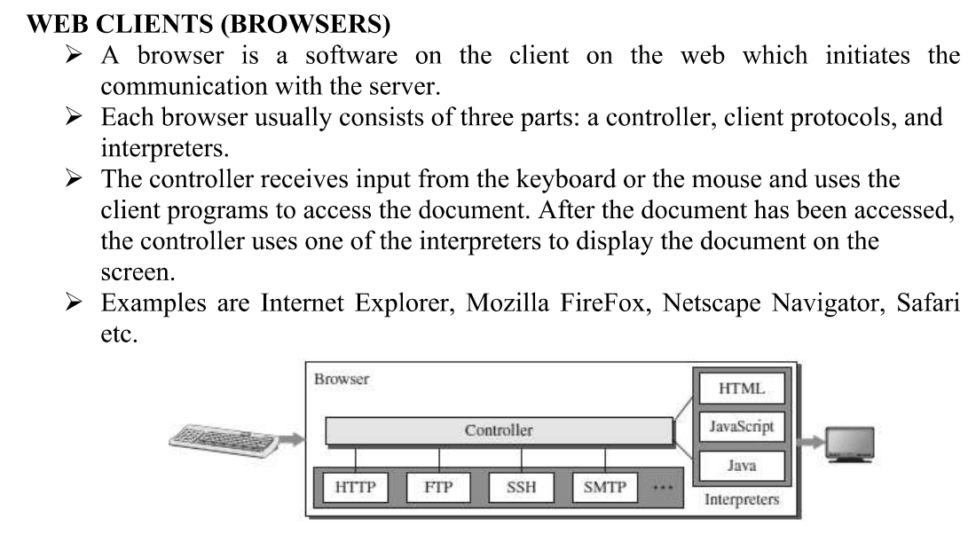

Slide 5
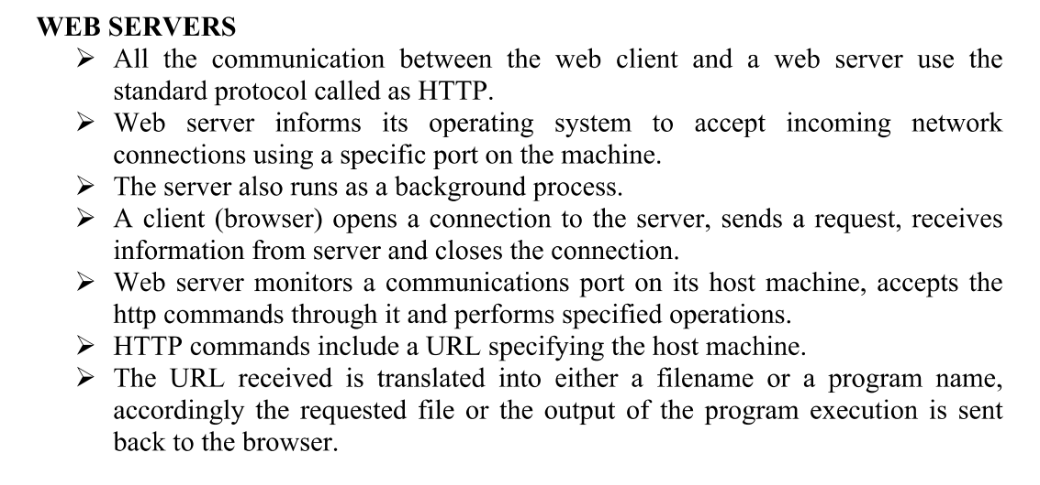

Slide 6
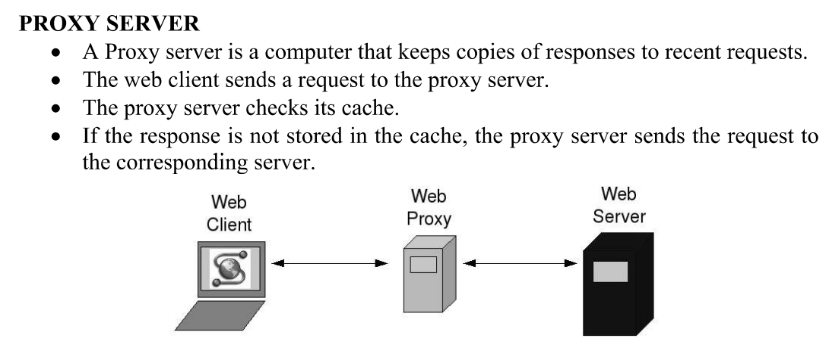

Slide 7
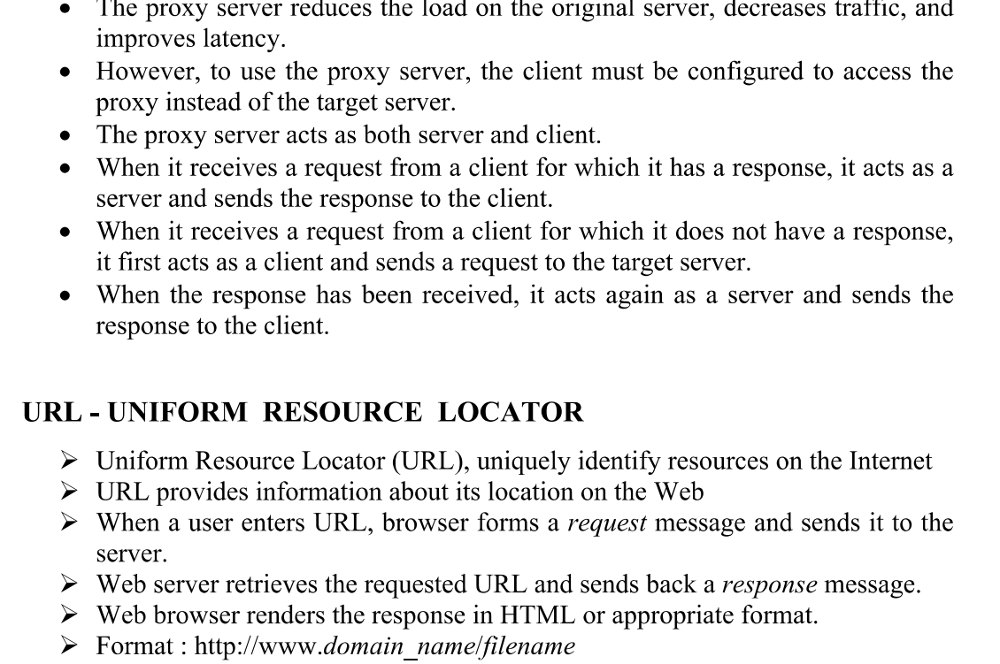

Slide 8
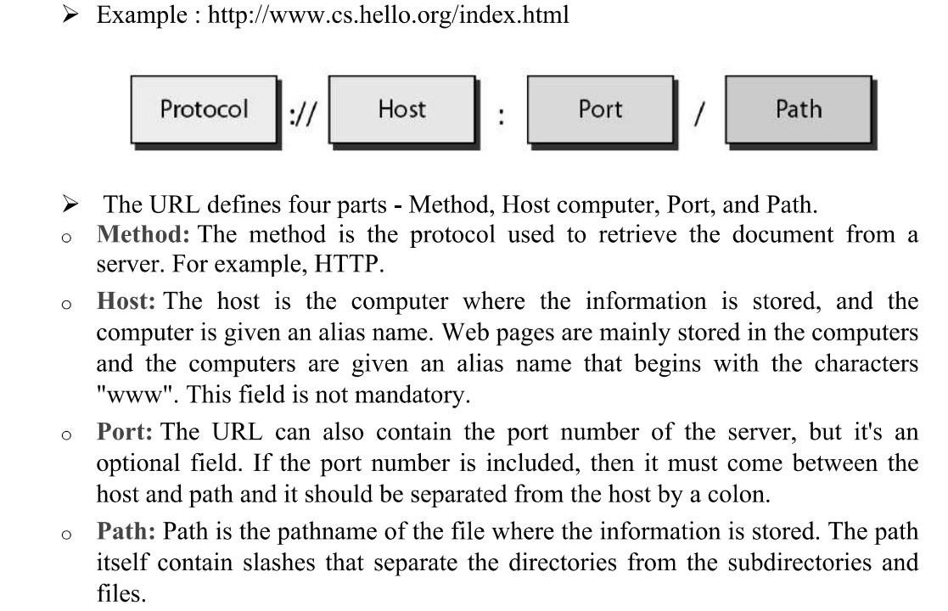

Slide 9
2. Write about E-mail System?
E-mail system comprises of the following three components:
• Mailer
• Mail Server
• Mailbox
Mailer :It is also called mail program, mail application or mail client. It allows us to manage, read and compose e-mail.
Mail Server : The function of mail server is to receive, store and deliver the email. It is must for mail servers to be Running all the time because if it crashes or is down, email can be lost.
Mailboxes : Mailbox is generally a folder that contains emails and information about them.

Slide 10
Working of E-mail : Email working follows the client server approach.
In this client is the mailer i.e. the mail application or mail program and server is a device that manages emails.
Following example describes the basic steps involved in sending and receiving emails and will give a better understanding of working of email system:
Suppose person A wants to send an email message to person B.
Person A composes the messages using a mailer program i.e. mail client and then select Send option.
The message is routed to Simple Mail Transfer Protocol to person B’s mail server.
The mail server stores the email message on disk in an area designated for person B.
The disk space area on mail server is called mail spool.
Now, suppose person B is running a POP client and knows how to communicate with B’s mail server.
It will periodically poll the POP server to check if any new email has arrived for B.
As in this case, person B has sent an email for person B, so email is forwarded over the network to B’s PC. This is message is now stored on person B’s PC.

Slide 11
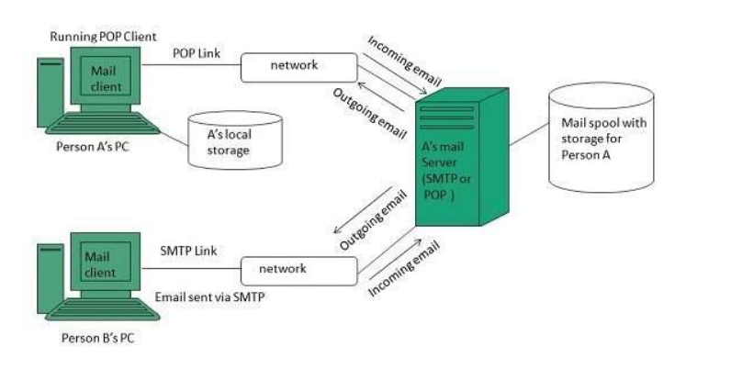
The following diagram gives pictorial representation of the steps discussed above:

Slide 12
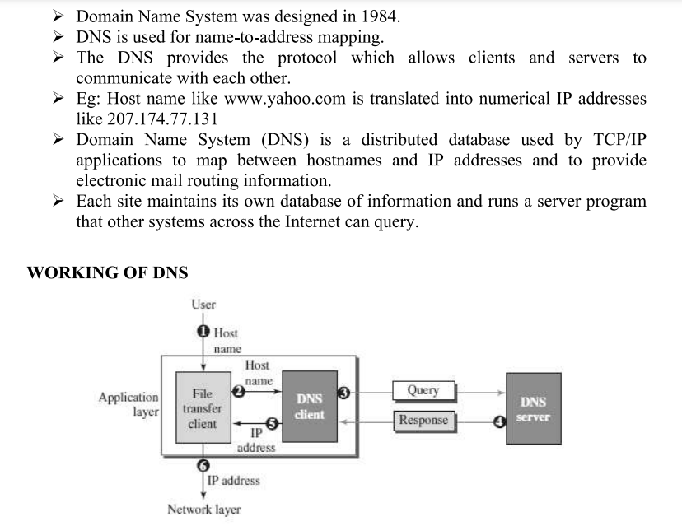
3.Explain Domain Name System(DNS)?

Slide 13
A user wants to use a file transfer client to access the corresponding file transfer server running on a remote host.
The user knows only the file transfer server name, such as afilesource.com.
Name Space :A name space that maps each address to a unique name can be organized in two ways: flat or hierarchical.
In a flat name space, a name is assigned to an address. A name in this space is a sequence of characters without structure.
In a hierarchical name space, each name is made of several parts.
Domain Name Space : To have a hierarchical name space, a domain name space was designed.
In this design the names are defined in an inverted-tree structure with the root at the top.

Slide 14
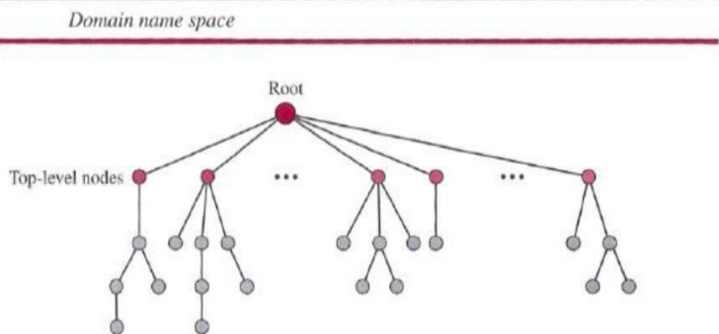

Slide 15
Label : Each node in the tree has a label, which is a string with a maximum of 63 characters.
The root label is a null string (empty string).
Domain Name : If a label is terminated by a null string, it is called a fully qualified domain name (FQDN).
If a label is not terminated by a null string, it is called a partially qualified domain name PQDN).
Domain : A domain is a sub tree of the domain name space.
The name of the domain is the name of the node at the top of the sub tree.

Slide 16
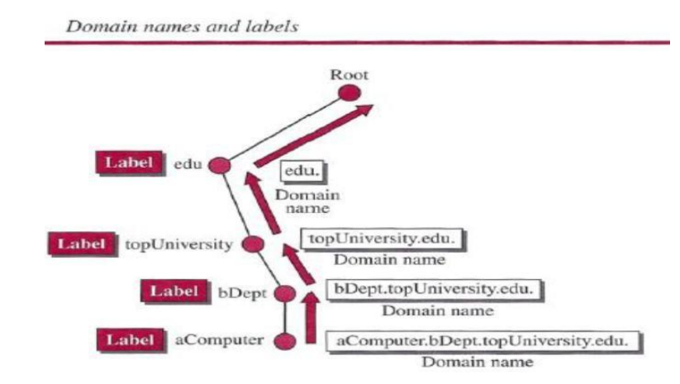

Slide 17
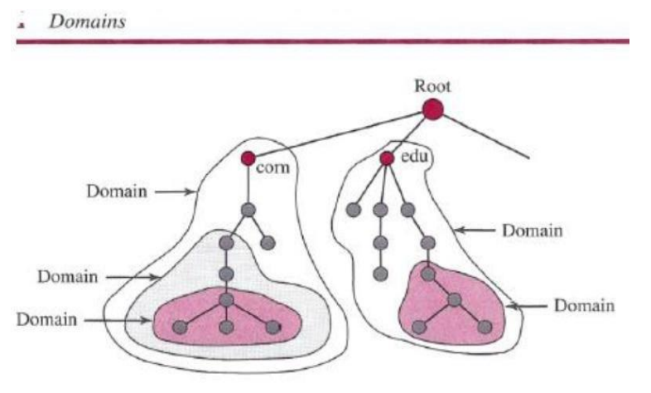

Slide 18
Distribution of Name Space : The information contained in the domain name space must be stored.
However, it is very inefficient and also not reliable to have just one computer store such a huge amount of information.
It is inefficient because responding to requests from all over the world places a heavy load on the system it is not reliable because any failure makes the data inaccessible.
Zone : Since the complete domain name hierarchy cannot be stored on a single server, it is divided among many servers.
What a server is responsible for or has authority over is called a zone.
The server makes a database called a zone file and keeps all the information for every node under that domain.

Slide 19
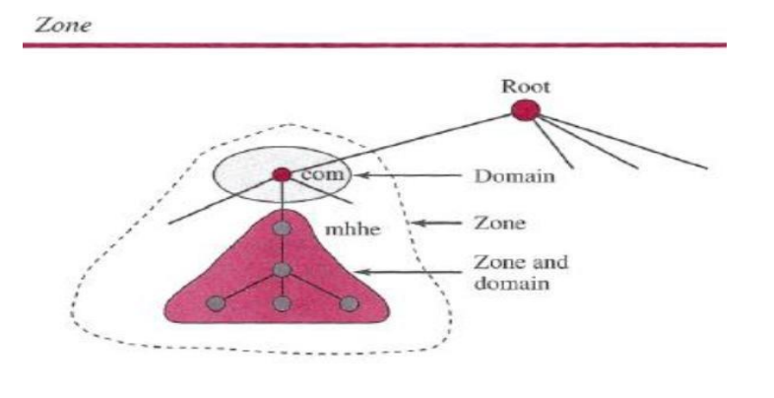

Slide 20
4.Explain Flow control techniques to improve QOS?
To improve the quality of service four commonly used techniques are- scheduling, traffic shaping, admission control, and resource reservation.
(write about different scheduling methods in QOS)
Scheduling :
Packets from different flows arrive at a switch or router for processing.
A good scheduling technique treats the different flows in a fair and appropriate manner.
Several scheduling techniques are designed to improve the quality of service.
Three of them here: FIFO queuing, priority queuing, and weighted fair queuing.
FIFO Queuing :In first-in, first-out (FIFO) queuing, packets wait in a buffer (queue) until the node (router or switch) is ready to process them.
If the average arrival rate is higher than the average processing rate, the queue will fill up and new packets will be discarded.
A FIFO queue is familiar to those who have had to wait for a bus at a bus stop.
Figure below shows a conceptual view of a FIFO queue.

Slide 21
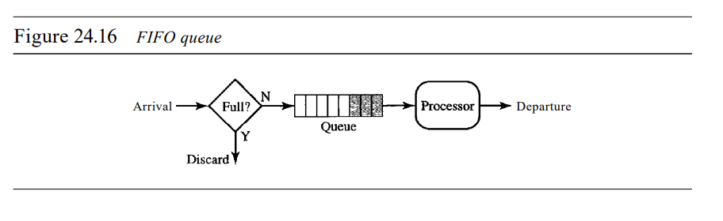

Slide 22
Priority Queuing :
In priority queuing, packets are first assigned to a priority class.
Each priority class has its own queue.
The packets in the highest-priority queue are processed first.
Packets in the lowest-priority queue are processed last.
The system does not stop serving a queue until it is empty.
Figure below shows priority queuing with two priority levels (for simplicity)

Slide 23
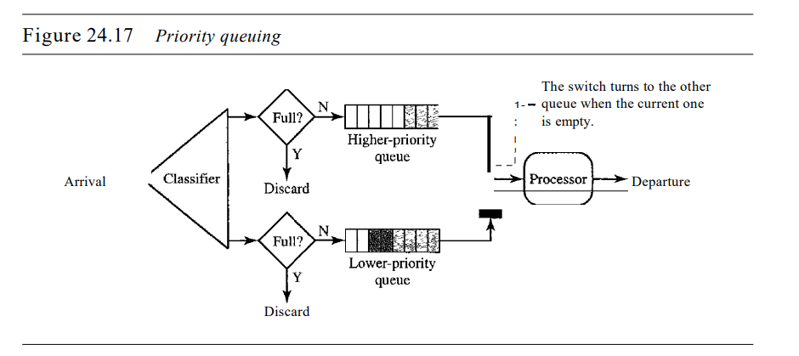

Slide 24
A priority queue can provide better QoS than the FIFO queue because higher priority traffic, such as multimedia, can reach the destination with less delay. However, there is a potential drawback.
If there is a continuous flow in a high-priority queue, the packets in the lower-priority queues will never have a chance to be processed. This is a condition called starvation.
Weighted Fair Queuing :A better scheduling method is weighted fair queuing.
In this technique, the packets are still assigned to different classes and admitted to different queues.
The queues, however, are weighted based on the priority of the queues; higher priority means a higher weight.
The system processes packets in each queue in a round-robin fashion with the number of packets selected from each queue based on the corresponding weight.
For example, if the weights are 3, 2, and 1, three packets are processed from the first queue, two from the second queue, and one from the third queue.
If the system does not impose priority on the classes, all weights can be equaL In this way, we have fair queuing with priority.
Figure below shows the technique with three classes.

Slide 25
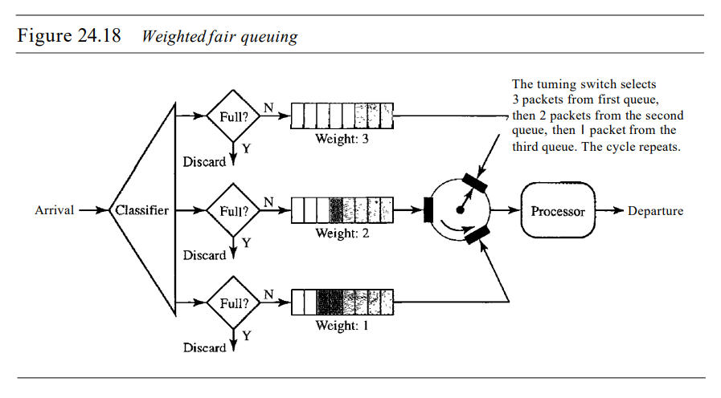

Slide 26
(write about the techniques used in traffic shaping in QOS/ Explain Leaky bucket and token bucket techniques)
Traffic Shaping :Traffic shaping is a mechanism to control the amount and the rate of the traffic sent to the network.
Two techniques can shape traffic: leaky bucket and token bucket.
Leaky Bucket: If a bucket has a small hole at the bottom, the water leaks from the bucket at a constant rate as long as there is water in the bucket.
The rate at which the water leaks does not depend on the rate at which the water is input to the bucket unless the bucket is empty.
The input rate can vary, but the output rate remains constant.
Similarly, in networking, a technique called leaky bucket can smooth out bursty traffic.
Bursty chunks are stored in the bucket and sent out at an average rate.
Figure below shows a leaky bucket and its effects.

Slide 27
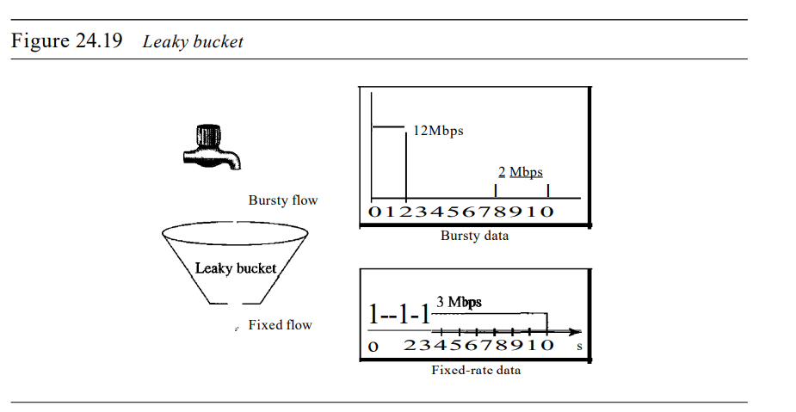

Slide 28
In the figure, we assume that the network has committed a bandwidth of 3 Mbps for a host.
The use of the leaky bucket shapes the input traffic to make it conform to this commitment.
In the Figure the host sends a burst of data at a rate of 12 Mbps for 2 s, for a total of 24 Mbits of data.
The host is silent for 5 s and then sends data at a rate of 2 Mbps for 3 s, for a total of 6 Mbits of data. In all, the host has sent 30 Mbits of data in lOs.
The leaky bucket smooths the traffic by sending out data at a rate of 3 Mbps during the same 10 s.
Without the leaky bucket, the beginning burst may have hurt the network by consuming more bandwidth than is set aside for this host.
We can also see that the leaky bucket may prevent congestion.
A simple leaky bucket implementation is shown in Figure below.

Slide 29
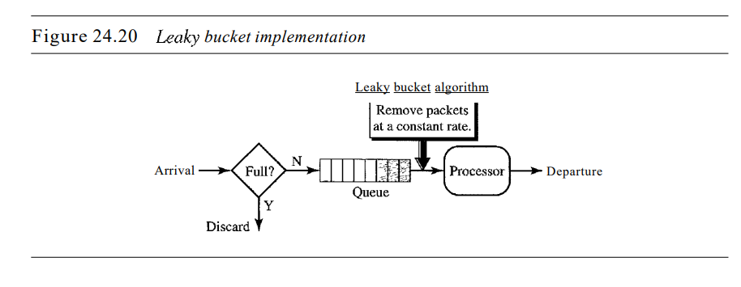

Slide 30
Token Bucket :The leaky bucket is very restrictive. It does not credit an idle host.
For example, if a host is not sending for a while, its bucket becomes empty. Now if the host has bursty data, the leaky bucket allows only an average rate. T
he time when the host was idle is not taken into account.
On the other hand, the token bucket algorithm allows idle hosts to accumulate credit for the future in the form of tokens.
For each tick of the clock, the system sends n tokens to the bucket. The system removes one token for every cell (or byte) of data sent.
For example, if n is 100 and the host is idle for 100 ticks, the bucket collects 10,000 tokens.
Now the host can consume all these tokens in one tick with 10,000 cells, or the host takes 1000 ticks with 10 cells per tick.
In other words, the host can send bursty data as long as the bucket is not empty.
Figure below shows the idea. The token bucket can easily be implemented with a counter.
The token is initialized to zero. Each time a token is added, the counter is incremented by 1. Each time a unit of data is sent, the counter is decremented by 1. When the counter is zero, the host cannot send data.

Slide 31
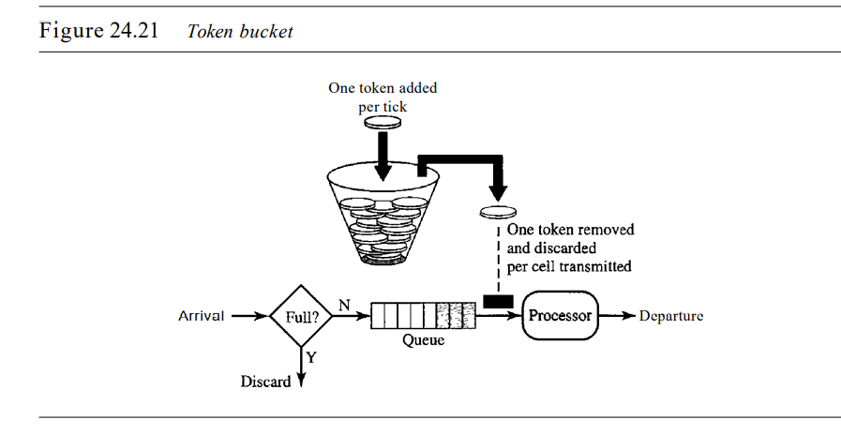

Slide 32
Combining Token Bucket and Leaky Bucket :The two techniques can be combined to credit an idle host and at the same time regulate the traffic.
The leaky bucket is applied after the token bucket; the rate of the leaky bucket needs to be higher than the rate of tokens dropped in the bucket.
Resource Reservation : A flow of data needs resources such as a buffer, bandwidth, CPU time, and so on.
The quality of service is improved if these resources are reserved beforehand.
Admission Control :Admission control refers to the mechanism used by a router, or a switch, to accept or reject a flow based on predefined parameters called flow specifications.
Before a router accepts a flow for processing, it checks the flow specifications to see if its capacity (in terms of bandwidth, buffer size, CPU speed, etc.) and its previous commitments to other flows can handle the new flow.

Slide 33
5. Write about INTEGRATED SERVICES?
Two models have been designed to provide quality of service in the Internet: Integrated Services and Differentiated Services.
Both models emphasize the use of quality of service at the network layer (IP), although the model can also be used in other layers such as the data line.
IP was originally designed for best-effort delivery. This means that every user receives the same level of services.
This type of delivery does not guarantee the minimum of a service, such as bandwidth, to applications such as real-time audio and video.
If such an application accidentally gets extra bandwidth, it may be detrimental to other applications, resulting in congestion.
Integrated Services, sometimes called IntServ, is a flow-based QoS model, which means that a user needs to create a flow, a kind of virtual circuit, from the source to the destination and inform all routers of the resource requirement.

Slide 34
Signaling : IP is a connectionless, datagram, packet-switching protocol.
Flow-based model over a connectionless protocol is implemented by signaling.
A protocol has to run over IP that provides the signaling mechanism for making a reservation. This protocol is called Resource Reservation Protocol (RSVP).
Flow Specification : When a source makes a reservation, it needs to define a flow specification.
A flow spedfication has two parts: Rspec (resource specification) and Tspec (traffic specification).
Rspec defines the resource that the flow needs to reserve (buffer, bandwidth, etc.).
Tspec defines the traffic characterization of the flow.

Slide 35
Admission :
After a router receives the flow specification from an application, it decides to admit or deny the service.
The decision is based on the previous commitments of the router and the current availability of the resource.
Service Classes : Two classes of services have been defined for Integrated Services: guaranteed service and controlled-load service.
Guaranteed Service Class :This type of service is designed for real-time traffic that needs a guaranteed minimum end-to-end delay.
The end-to-end delay is the sum of the delays in the routers, the propagation delay in the media, and the setup mechanism.
Only the first, the sum of the delays in the routers, can be guaranteed by the router.
This type of service guarantees that the packets will arrive within a certain delivery time and are not discarded if flow traffic stays within the boundary of Tspec.

Slide 36
We can say that guaranteed services are quantitative services, in which the amount of end-to-end delay and the data rate must be defined by the application.
Controlled-Load Service Class :
This type of service is designed for applications that can accept some delays, but are sensitive to an overloaded network and to the danger of losing packets.
Good examples of these types of applications are file transfer, e-mail, and Internet access.
The controlled load service is a qualitative type ofservice in that the application requests the possibility of low-loss or no-loss packets.

Slide 37
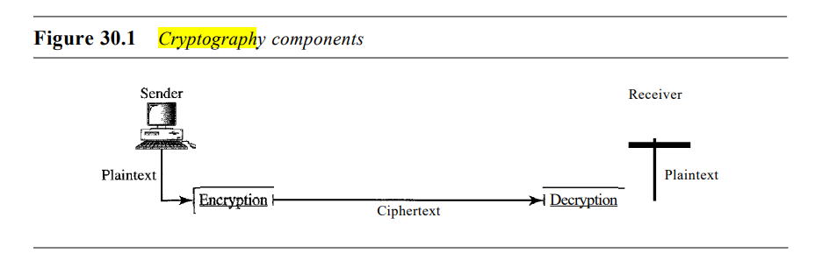
6.Write about the definition and terms used in CRYPTOGRAPHY ?
Cryptography, a word with Greek origins, means "secret writing.“
The time Cryptography refers to the science and art of transforming messages to make them secure and immune to attacks.
Figure below shows the components involved in cryptography.

Slide 38
Plaintext and Ciphertext :
The original message, before being transformed, is called plaintext.
After the message is transformed, it is called ciphertext.
An encryption algorithm transforms the plaintext into ciphertext; a decryption algorithm transforms the ciphertext back into plaintext.
The sender uses an encryption algorithm, and the receiver uses a decryption algorithm.
Cipher :The encryption and decryption algorithms are referred as ciphers.
The term cipher is also used to refer to different categories of algorithms in cryptography.
This is not to say that every sender-receiver pair needs their very own unique cipher for a secure communication. On the contrary, one cipher can serve millions of communicating pairs.

Slide 39
Key : A key is a number (or a set of numbers) that the cipher, as an algorithm, operates on.
To encrypt a message, we need an encryption algorithm, an encryption key, and the plaintext. These create the ciphertext.
To decrypt a message, we need a decryption algorithm, a decryption key, and the ciphertext. These reveal the original plaintext.
7. Write about different categories of Cryptography?
cryptography algorithms (ciphers) are divided into two groups: symmetrickey (also called secret-key) cryptography algorithms and asymmetric (also called public-key) cryptography algorithms.

Slide 40
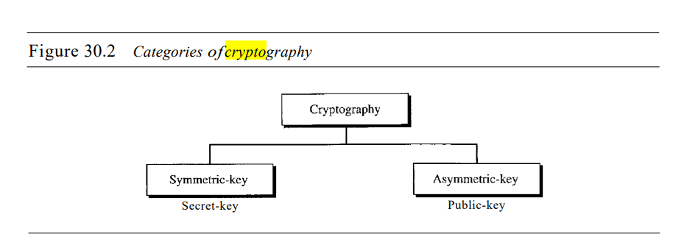

Slide 41
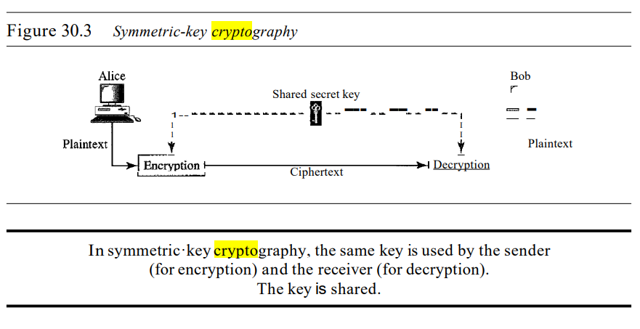
Symmetric·Key Cryptography : In symmetric-key cryptography, the same key is used by both parties.
The sender uses this key and an encryption algorithm to encrypt data; the receiver uses the same key and the corresponding decryption algorithm to decrypt the data.

Slide 42
Asymmetric-Key Cryptography :
In asymmetric or public-key cryptography, there are two keys: a private key and a public key.
The private key is kept by the receiver.
The public key is announced to the public.
In Figure 30.4, imagine Alice wants to send a message to Bob.
Alice uses the public key to encrypt the message.
When the message is received by Bob, the private key is used to decrypt the message.

Slide 43
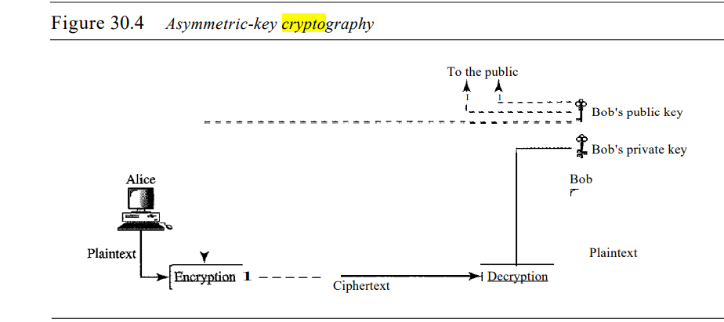

Slide 44
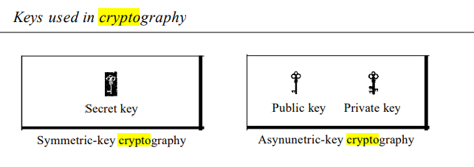
8. What are the different keys used in Cryptography?
Three types of keys are used in cryptography: the secret key, the public key, and the private key.
The first, the secret key, is the shared key used in symmetric-key cryptography.
The second and the third are the public and private keys used in asymmetric-key cryptography.

Slide 46
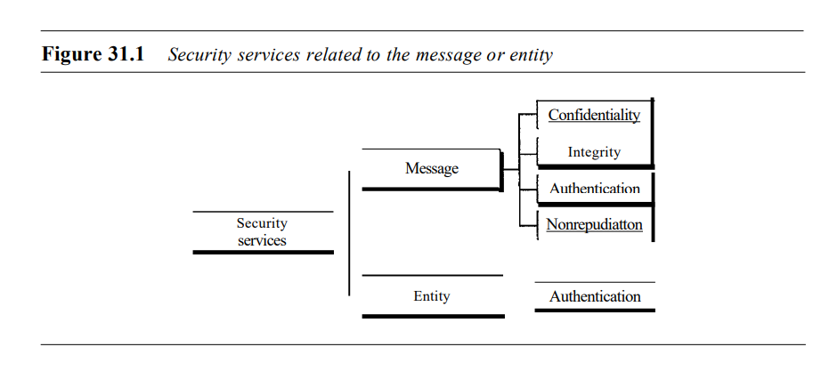
9.Write a note on SECURITY SERVICES?
Network security can provide one of the five services as shown in the Figure . Four of these services are related to the message exchanged using the network: message confidentiality, integrity, authentication, and nonrepudiation. The fifth service provides entity authentication or identification.

Slide 47
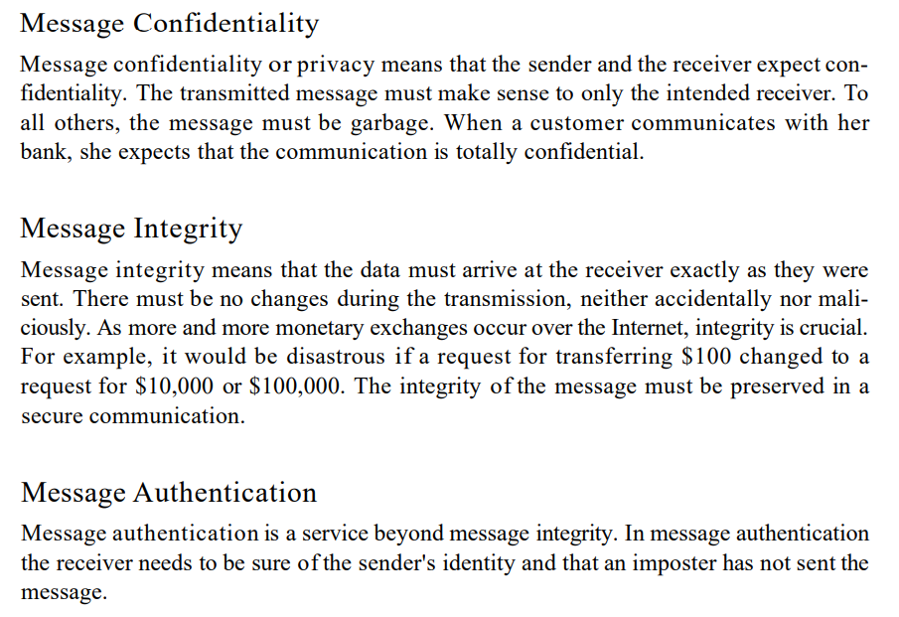

Slide 48
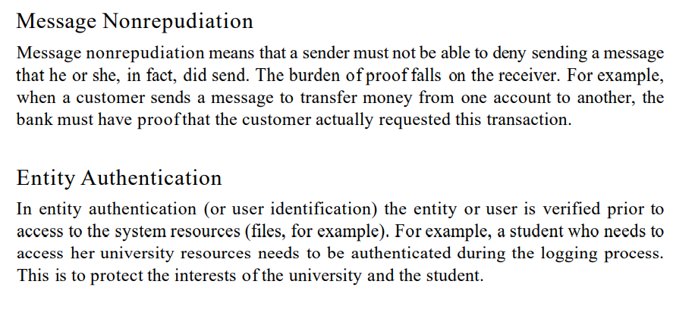

Slide 49
10.Write a note on privacy or confidentialily in cryprography?
Or write about different encryption methods?
The concept of how to achieve privacy has not been changed for thousands of years: the message cannot be encrypted.
The message must be rendered as opaque to all the unauthorized parties.
A good encryption/decryption technique is used to achieve privacy to some extent.
This technique ensures that the eavesdropper cannot understand the contents of the message.
Encryption/Decryption
Encryption: Encryption means that the sender converts the original information into another form and sends the unintelligible message over the network.

Slide 50
Decryption: Decryption reverses the Encryption process in order to transform the message back to the original form.
The data which is to be encrypted at the sender site is known as plaintext, and the encrypted data is known as ciphertext. The data is decrypted at the receiver site.
There are two types of Encryption/Decryption techniques:
Privacy with secret key Encryption/Decryption
Privacy with public key Encryption/Decryption

Slide 51
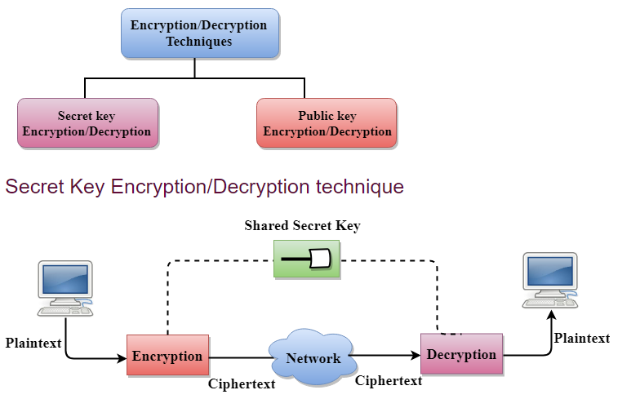

Slide 52
In Secret Key Encryption/Decryption technique, the same key is used by both the parties, i.e., the sender and receiver.
The sender uses the secret key and encryption algorithm to encrypt the data; the receiver uses this key and decryption algorithm to decrypt the data.
In Secret Key Encryption/Decryption technique, the algorithm used for encryption is the inverse of the algorithm used for decryption. It means that if the encryption algorithm uses a combination of addition and multiplication, then the decryption algorithm uses a combination of subtraction and division.
The secret key encryption algorithm is also known as symmetric encryption algorithm because the same secret key is used in bidirectional communication.
In secret key encryption/decryption algorithm, the secret code is used by the computer to encrypt the information before it is sent over the network to another computer.
The secret key requires that we should know which computers are talking to each other so that we can install the key on each computer.

Slide 53
Data Encryption Standard (DES)
The Data Encryption Standard (DES) was designed by IBM and adopted by the U.S. government as the standard encryption method for nonmilitary and nonclassified use.
The Data Encryption Standard is a standard used for encryption, and it is a form of Secret Key Cryptography.
Advantage
Efficient: The secret key algorithms are more efficient as it takes less time to encrypt the message than to encrypt the message by using a public key encryption algorithm. The reason for this is that the size of the key is small. Due to this reason, Secret Key Algorithms are mainly used for encryption and decryption.
Disadvantages of Secret Key Encryption
The Secret Key Encryption/Decryption has the following disadvantages:
Each pair of users must have a secret key. If the number of people wants to use this method in the world is N, then there are N(N-1)/2 secret keys. For example, for one million people, then there are half billion secret keys.
The distribution of keys among different parties can be very difficult. This problem can be resolved by combining the Secret Key Encryption/Decryption with the Public Key Encryption/Decryption algorithm.

Slide 54
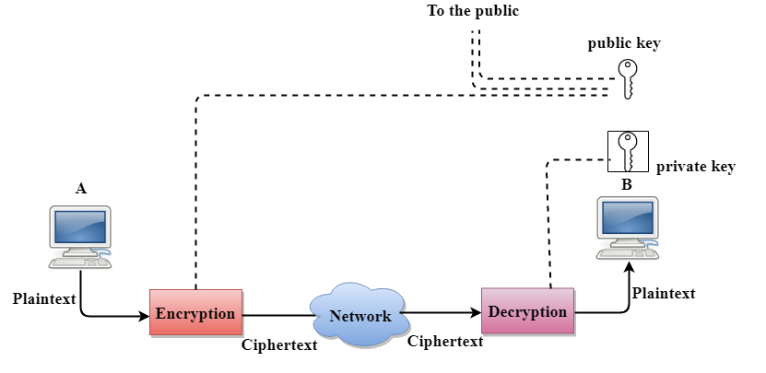
Public Key Encryption/Decryption technique
There are two keys in public key encryption: a private key and a public key.
The private key is given to the receiver while the public key is provided to the public.

Slide 55
In the above figure, we see that A is sending the message to user B. 'A' uses the public key to encrypt the data while 'B' uses the private key to decrypt the data.
In public key Encryption/Decryption, the public key used by the sender is different from the private key used by the receiver.
The public key is available to the public while the private key is kept by each individual.
The most commonly used public key algorithm is known as RSA.
Advantages of Public Key Encryption
The main restriction of private key encryption is the sharing of a secret key. A third party cannot use this key. In public key encryption, each entity creates a pair of keys, and they keep the private one and distribute the public key.
The number of keys in public key encryption is reduced tremendously. For example, for one million users to communicate, only two million keys are required, not a half-billion keys as in the case of secret key encryption.

Slide 56
Disadvantages of Public Key Encryption
Speed: One of the major disadvantage of the public-key encryption is that it is slower than secret-key encryption. In secret key encryption, a single shared key is used to encrypt and decrypt the message which speeds up the process while in public key encryption, different two keys are used, both related to each other by a complex mathematical process. Therefore, we can say that encryption and decryption take more time in public key encryption.
Authentication: A public key encryption does not have a built-in authentication. Without authentication, the message can be interpreted or intercepted without the user's knowledge.
Inefficient: The main disadvantage of the public key is its complexity. If we want the method to be effective, large numbers are needed. But in public key encryption, converting the plaintext into ciphertext using long keys takes a lot of time. Therefore, the public key encryption algorithms are efficient for short messages not for long messages.

Slide 57
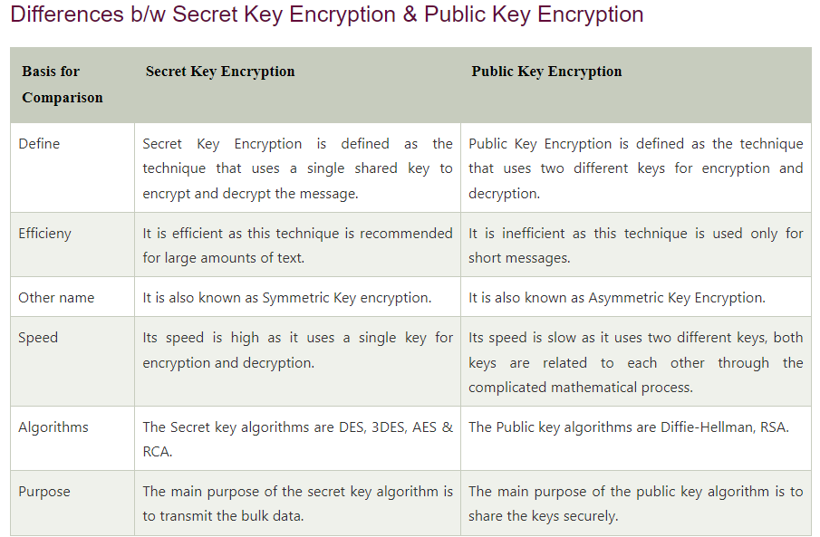
11. Write the differences between secret key encryption and public key encryption?

Slide 58
12. Explain the other aspects of security ?
Or Explain about digital signature in security?
Digital Signature
The Digital Signature is a technique which is used to validate the authenticity and integrity of the message. We know that there are four aspects of security: privacy, authentication, integrity, and non-repudiation. We have already discussed the first aspect of security and other three aspects can be achieved by using a digital signature.
The basic idea behind the Digital Signature is to sign a document. When we send a document electronically, we can also sign it. We can sign a document in two ways: to sign a whole document and to sign a digest.
Signing the Whole Document
In Digital Signature, a public key encryption technique is used to sign a document. However, the roles of a public key and private key are different here. The sender uses a private key to encrypt the message while the receiver uses the public key of the sender to decrypt the message.
In Digital Signature, the private key is used for encryption while the public key is used for decryption.
Digital Signature cannot be achieved by using secret key encryption.

Slide 59
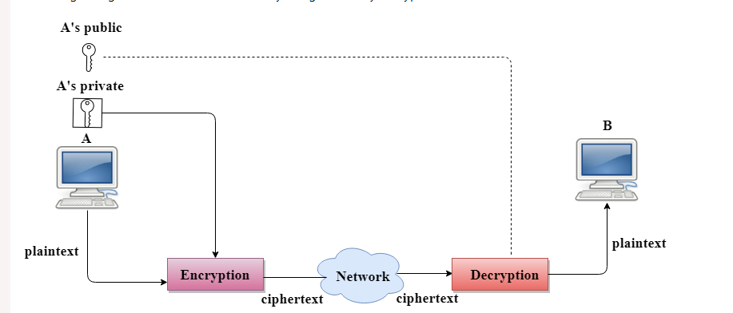

Slide 60
Digital Signature is used to achieve the following three aspects:
Integrity: The Digital Signature preserves the integrity of a message because, if any malicious attack intercepts a message and partially or totally changes it, then the decrypted message would be impossible.
Authentication: We can use the following reasoning to show how the message is authenticated. If an intruder (user X) sends a message pretending that it is coming from someone else (user A), user X uses her own private key to encrypt the message. The message is decrypted by using the public key of user A. Therefore this makes the message unreadable. Encryption with X's private key and decryption with A's public key results in garbage value.
Non-Repudiation: Digital Signature also provides non-repudiation. If the sender denies sending the message, then her private key corresponding to her public key is tested on the plaintext. If the decrypted message is the same as the original message, then we know that the sender has sent the message.

Slide 61
Signing the Digest
Public key encryption is efficient if the message is short. If the message is long, a public key encryption is inefficient to use. The solution to this problem is to let the sender sign a digest of the document instead of the whole document.
The sender creates a miniature version (digest) of the document and then signs it, the receiver checks the signature of the miniature version.
The hash function is used to create a digest of the message. The hash function creates a fixed-size digest from the variable-length message.
The two most common hash functions used: MD5 (Message Digest 5) and SHA-1 (Secure Hash Algorithm 1). The first one produces 120-bit digest while the second one produces a 160-bit digest.
A hash function must have two properties to ensure the success:
First, the digest must be one way, i.e., the digest can only be created from the message but not vice versa.
Second, hashing is a one-to-one function, i.e., two messages should not create the same digest.

Slide 62
Following are the steps taken to ensure security:
The miniature version (digest) of the message is created by using a hash function.
The digest is encrypted by using the sender's private key.
After the digest is encrypted, then the encrypted digest is attached to the original message and sent to the receiver.
The receiver receives the original message and encrypted digest and separates the two. The receiver implements the hash function on the original message to create the second digest, and it also decrypts the received digest by using the public key of the sender. If both the digests are same, then all the aspects of security are preserved.

Slide 63
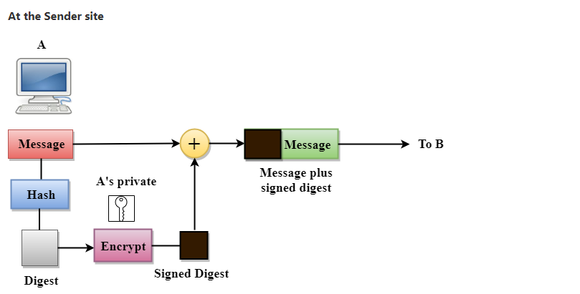

Slide 64
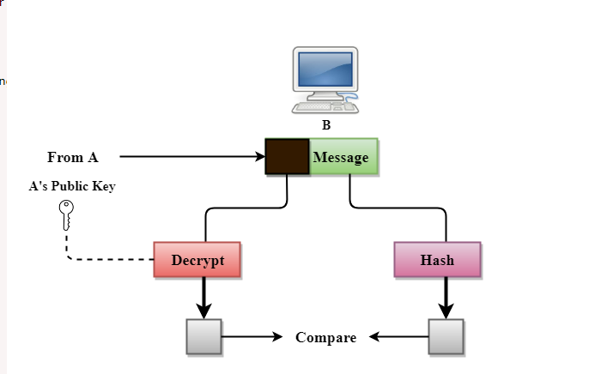
At receiver’s site:

